Slide 1

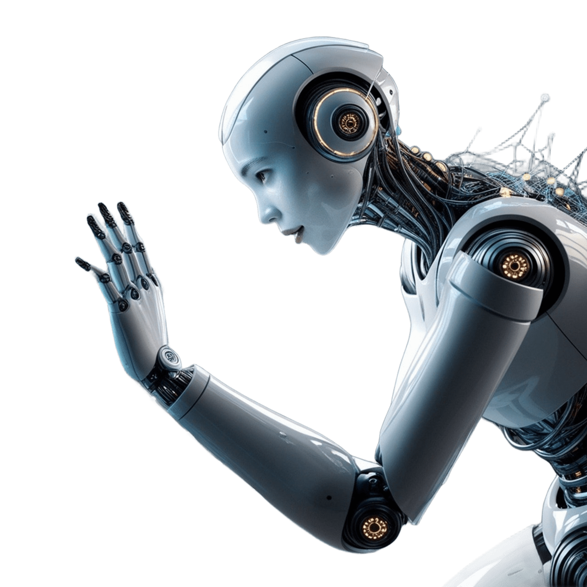
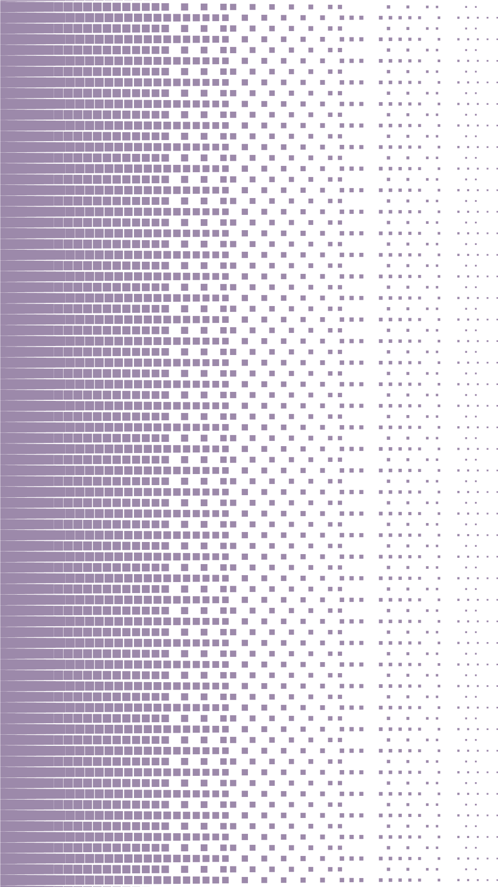
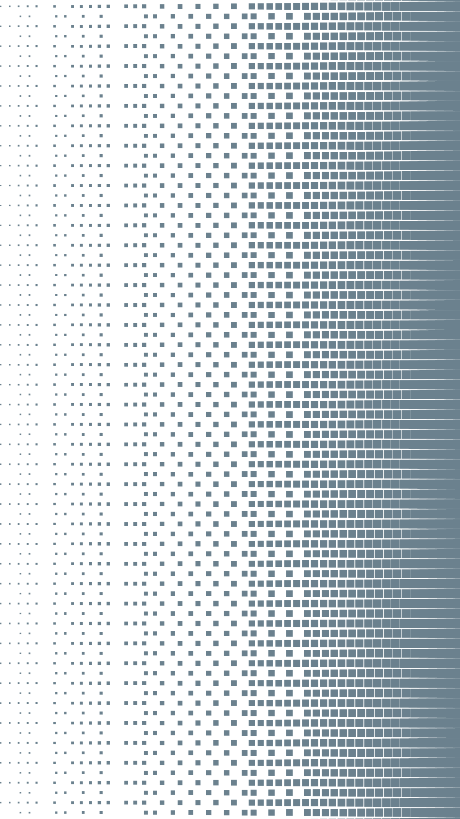


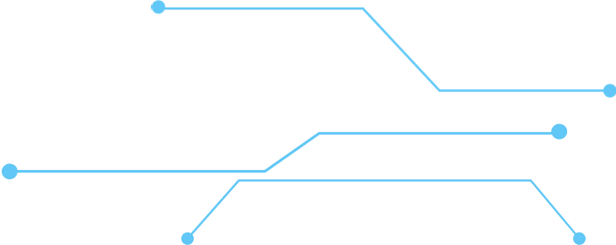

COMPARATIVE INTELLIGENCE
AND ETHICS IN MACHINE LEARNING
A comparison of HOG-SVM and CNN for waste image classification
PRESENTATION
TrashNet • Classification • Explainability • Robustness • Responsible AI
BY: EMILY SHAIBU
Notes:
Good afternoon, everyone.
My name is Emily Shaibu, and today I will be presenting my study titled Comparative Intelligence and Ethics in Machine Learning Systems.
Imagine a waste-sorting facility where AI identifies materials such as cardboard, glass, metal, paper, and plastic. Incorrect classifications could affect sorting efficiency and reduce the amount of material successfully recycled. This makes waste classification an interesting practical application of computer vision.
In this study, I compare two approaches: HOG-SVM, a traditional machine-learning method, and a Convolutional Neural Network, or CNN, a deep-learning approach.
Beyond accuracy, I examine class-level performance, explainability, sensitivity to image brightness, and the ethical implications of using these models.
Ultimately, my study asks: Does better performance automatically make a model the better choice, or must we also consider its reliability, limitations, and ethical implications?

Slide 2

Why compare these models?
Automated waste classification can support sorting—but a prediction is only useful if it is reliable
The challenge
The model choice
The responsibility
Errors can affect sorting quality. Accuracy alone does not show all failure modes.
Materials can share shape, colour, transparency and reflective properties.
HOG-SVM uses engineered visual features; a CNN learns features from images.
Research question
How do HOG-SVM and CNN compare on waste-image classification, and what do their performance, explainability and robustness reveal about responsible deployment?
Conceptual framing informed by LeCun, Bengio and Hinton (2015) and NIST (2023).
Notes:
Having established the practical problem, the next question is why it is useful to compare these two approaches.
HOG-SVM represents a traditional machine-learning approach, where image features are extracted before the classifier makes a prediction. A CNN, on the other hand, learns features from the training images as part of the learning process.
Comparing them allows us to investigate whether the more complex deep-learning approach actually provides better results for this particular dataset.
I am also interested in more than overall accuracy. A model might perform well overall while struggling to identify a particular category of waste. Similarly, a model's predictions may be affected by changes in image conditions, and its decision-making process may not be immediately transparent.
Therefore, this study compares overall performance, class-level errors, explainability, and sensitivity to image brightness. These dimensions help us assess not only which model performs better, but also what its limitations might mean for practical use.

Slide 3

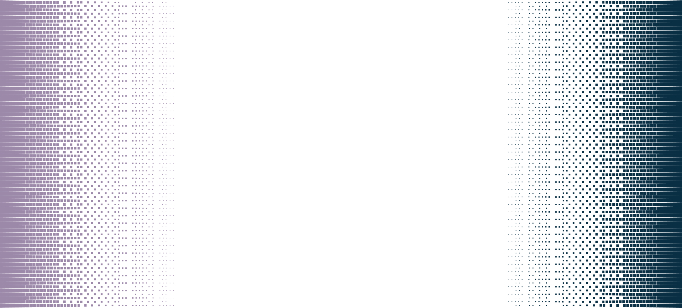



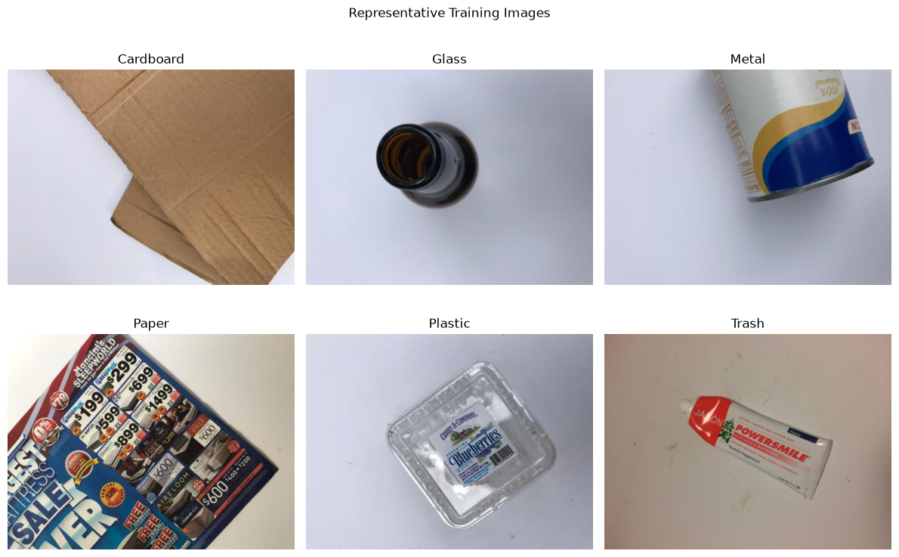
Exploratory data analysis: six waste categories
TrashNet contains 2,527 RGB images across six categories.
Class distribution
Cardboard 403
Glass 501
Metal 410
Paper 594
Plastic 482
Trash 137
Key observation
Paper has over four times as many images as trash.
This is class imbalance, not evidence of demographic bias.
(Thung and Yang, 2016)
Notes:
The dataset used in this study is TrashNet, introduced by Thung and Yang. It contains 2,527 images across six categories: cardboard, glass, metal, paper, plastic, and trash.
One key finding from the exploratory data analysis is class imbalance. Paper has 594 images, compared with only 137 for trash. This means the model has fewer examples of the trash category to learn from.
The images also present visual challenges, as different materials can have similar shapes and appearances depending on lighting, orientation, and background.
These factors make it important to evaluate not only overall accuracy, but also how well each model performs across individual classes.
Finally, this imbalance reflects the distribution of waste categories in the dataset; it is not, by itself, evidence of demographic bias.

Slide 4

Study design at a glance
One dataset, two modelling approaches, multiple evaluation lenses.
Prepare
Model A
Model B
Evaluate
Interrogate
Resize images; inspect class distribution; stratified split.
CNN learns visual features through convolution and pooling.
Accuracy, precision, recall, F1 and confusion matrices.
Grad-CAM, brightness stress test, ethical assessment.
HOG feature extraction → feature scaling → RBF-SVM.
01
02
03
04
05
Split: 1,768 training • 379 validation • 380 test images
Methodological caution: the test set was inspected during CNN fine-tuning, so it was not fully independent at the end.
Notes:
The experimental workflow involved data preparation, model development, evaluation, explainability, robustness testing, and ethical reflection.
I divided the 2,527 images into stratified training, validation, and test sets of 1,768, 379, and 380 images, respectively.
For HOG-SVM, I extracted image features and selected the SVM parameters using validation macro F1-score. For the CNN, I monitored validation performance during training and fine-tuning.
I evaluated both models using accuracy, precision, recall, F1-score, and confusion matrices. I also used Grad-CAM to examine CNN predictions and a brightness stress test to assess sensitivity to changed image conditions.
One limitation is that I inspected the test results before and after CNN fine-tuning. Therefore, the test set was not completely independent of model development. Future work should reserve an untouched test set for the final evaluation.

Slide 5






Model A: HOG + Support Vector Machine
3. Classify with SVM
1. Extract HOG
2. Scale features
Represent edge directions and local gradient patterns in each image.
Standardise the engineered feature vectors before classification.
RBF kernel; class weights; C selected using validation macro F1.
Why this baseline?
It separates feature extraction from classification, giving a comparatively lightweight benchmark against which to assess automatic feature learning by the CNN.
Sources: Dalal and Triggs (2005); Cortes and Vapnik (1995).
Notes:
The first model combines Histogram of Oriented Gradients, or HOG, with a Support Vector Machine, or SVM.
HOG extracts numerical features representing image edges, contours, and shapes. These features are standardised and passed to an SVM, which classifies images into the six waste categories.
I used an RBF kernel and class weighting, and tested regularisation parameter values of 1, 10, and 100. Validation macro F1-scores were approximately 0.636, 0.643, and 0.643, respectively. I selected 10 because it achieved the same score as 100 with a smaller parameter value.
This approach provides a traditional machine-learning baseline, but its performance may be limited when different waste categories have similar visual features. The method draws on the work of Dalal and Triggs on HOG and Cortes and Vapnik on SVMs.

Slide 6
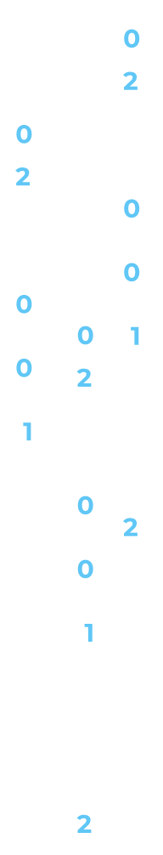
Model B: Convolutional Neural Network
96×96×3
Conv 32
Conv 64
Conv 128
Global avg.
Dropout
Dense 6
Input
+ MaxPool
+ MaxPool
+ MaxPool
pooling
0.30
Softmax
Training
Regularisation
Critical caveat
Adam (0.001); sparse categorical cross-entropy; class weights.
Augmentation, dropout, early stopping and learning-rate reduction.
Test-set results were reviewed before fine-tuning was complete.
CNNs learn hierarchical visual representations rather than relying on a fixed HOG feature descriptor.
Source: LeCun, Bengio and Hinton (2015).
Notes:
The second model is a Convolutional Neural Network, or CNN, implemented using TensorFlow and Keras.
CNNs learn visual patterns directly from images. Convolutional layers extract features, while max-pooling reduces their spatial dimensions, allowing the network to learn increasingly complex representations.
My architecture used three convolutional layers with 32, 64, and 128 filters, followed by global average pooling, dropout, and a six-neuron softmax output layer.
Images were resized to 96 by 96 pixels and normalised to values between zero and one. I applied data augmentation through horizontal flipping, rotation, and zooming to introduce variation during training.
The model used the Adam optimiser, sparse categorical cross-entropy, and class weights to address class imbalance. Early stopping and learning-rate reduction were used to guide training and fine-tuning.
The aim was to determine whether learning features directly from images would outperform the HOG-SVM approach. However, a more complex model does not automatically produce better results, particularly with limited training data and visually similar categories.

Slide 7






Evaluation: what do the metrics tell us?
ACCURACY
PRECISION
Overall proportion of correct predictions.
Of predictions for a class, how many were correct?
RECALL
F1-SCORE
Of actual examples in a class, how many were found?
Harmonic mean of precision and recall.
Why macro F1?
It gives each of the six classes equal weight, making weaker performance on underrepresented classes harder to hide behind the larger classes.
Source: Sokolova and Lapalme (2009).
Notes:
I used accuracy, precision, recall, F1-score, and confusion matrices because each provides a different perspective on classification performance.
Accuracy measures the proportion of correct predictions, while precision measures how often predictions for a particular class are correct. Recall measures how well the model identifies actual examples of that class.
F1-score combines precision and recall, helping us assess both false-positive predictions and missed examples.
I focused on macro-averaged metrics because they give equal weight to all six classes, preventing larger categories from dominating the overall results. Weighted averages are also useful because they account for the number of examples in each class.
Finally, confusion matrices reveal which categories are being confused with one another.
Together, these measures provide a more balanced evaluation than accuracy alone, consistent with the work of Sokolova and Lapalme.

Slide 8

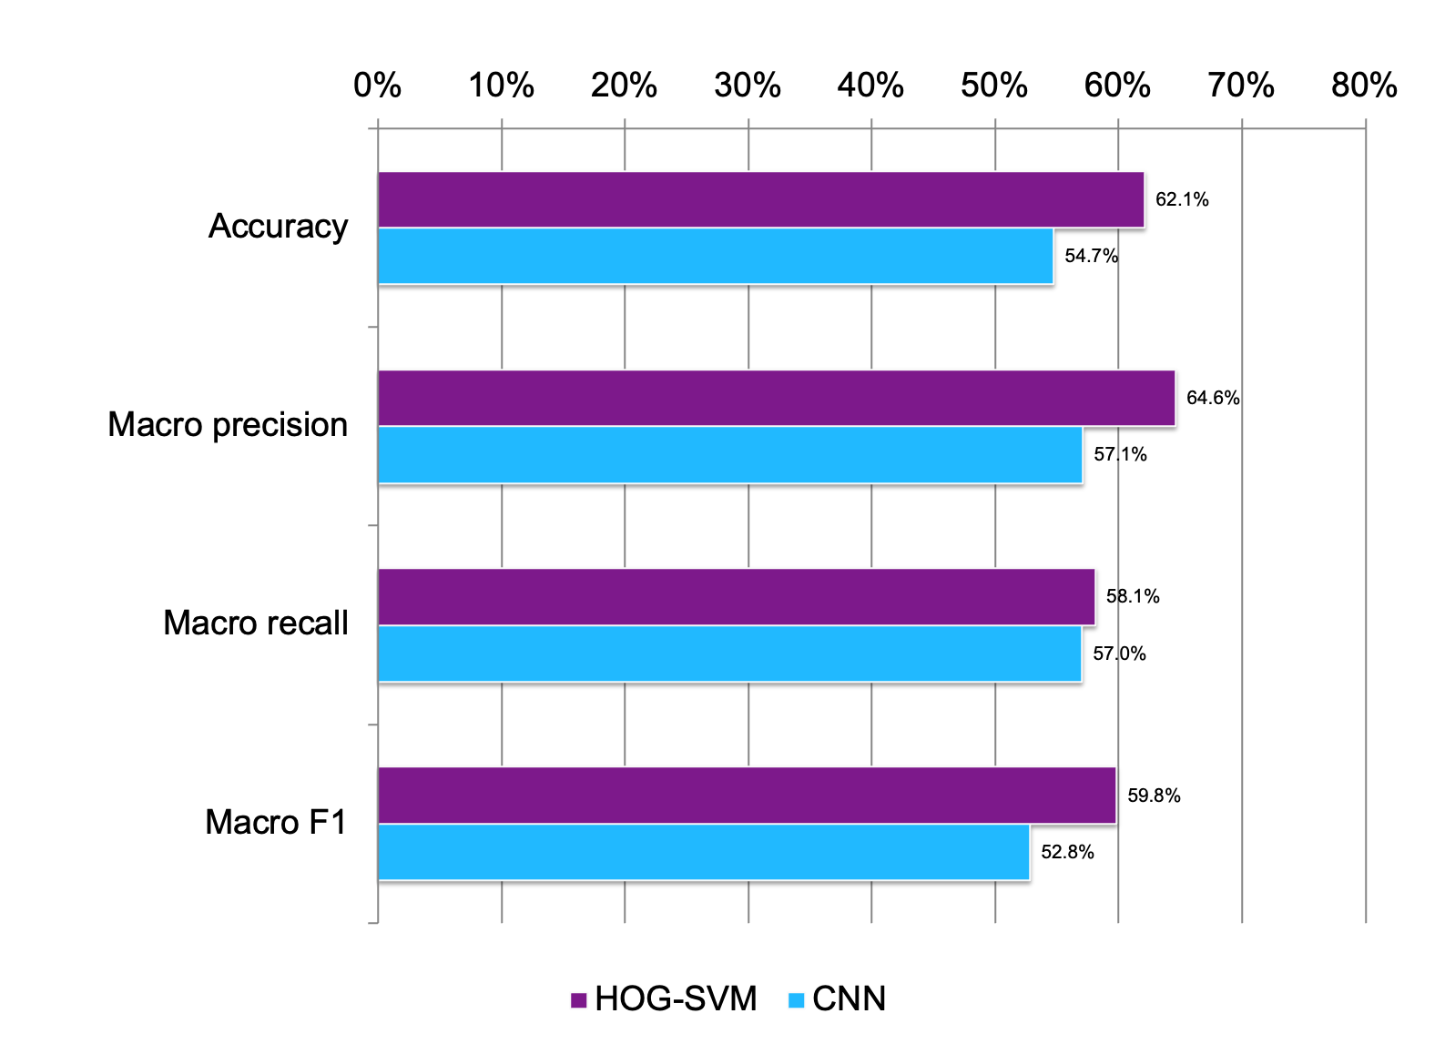

Results: HOG-SVM performed better overall
Accuracy gap
7.4 percentage points in favour of HOG-SVM.
Macro F1 gap
59.8% vs 52.8% — the difference persists when each class receives equal weight.
Interpret cautiously: the test set was inspected during CNN fine-tuning.
Notes:
The overall results show that HOG-SVM outperformed the CNN on the reported test metrics.
HOG-SVM achieved an accuracy of 62.1%, compared with 54.7% for the CNN. Its macro precision was 64.6%, compared with 57.1% for the CNN, while macro recall was relatively close at 58.1% and 57.0%, respectively.
The macro F1-score was 59.8% for HOG-SVM and 52.8% for the CNN. This indicates that the difference was not limited to overall accuracy; HOG-SVM also achieved a stronger balance of precision and recall across the classes.
One possible explanation is that HOG extracted useful shape and edge information for this particular dataset, while the CNN may have needed more representative training data or a different architecture to learn more effective features.
However, this experiment does not establish that traditional machine learning is generally superior to deep learning. It shows that HOG-SVM performed better under the particular data, architecture, and training conditions used here.
The results must also be interpreted in light of the test-set limitation discussed earlier. The figures are useful for comparison, but they should not be treated as a completely independent final estimate of generalisation performance.

Slide 9
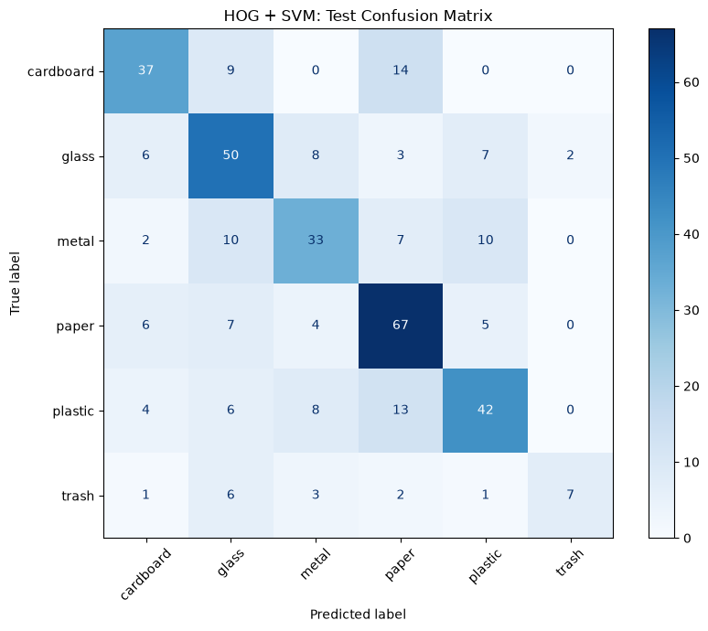

HOG-SVM: where did the model make errors?
Correct classifications
Paper: 67 of 89
Glass: 50 of 76
Notable confusion
Cardboard → paper: 14 cases
Plastic → paper: 13 cases
Trash recall
Only 7 of 20 trash images were correctly identified.
Notes:
The HOG-SVM confusion matrix provides more detail about the model's strengths and weaknesses.
The model correctly classified 67 of the 89 paper images and 50 of the 76 glass images. However, it confused cardboard with paper in 14 cases and plastic with paper in 13 cases.
These patterns suggest that the model struggled to distinguish some categories using the visual features captured by HOG. For example, cardboard and paper may share edge and surface characteristics, while the appearance of plastic objects can overlap with other categories.
Trash was also difficult to identify. Only seven of the 20 actual trash images were correctly classified, corresponding to a recall of 35%.
This is important because a model can perform reasonably well overall while still failing to identify a particular category consistently.
The confusion matrix therefore adds information that cannot be obtained from accuracy alone. It helps identify where further data collection, feature improvements, or alternative modelling approaches might be most valuable.

Slide 10
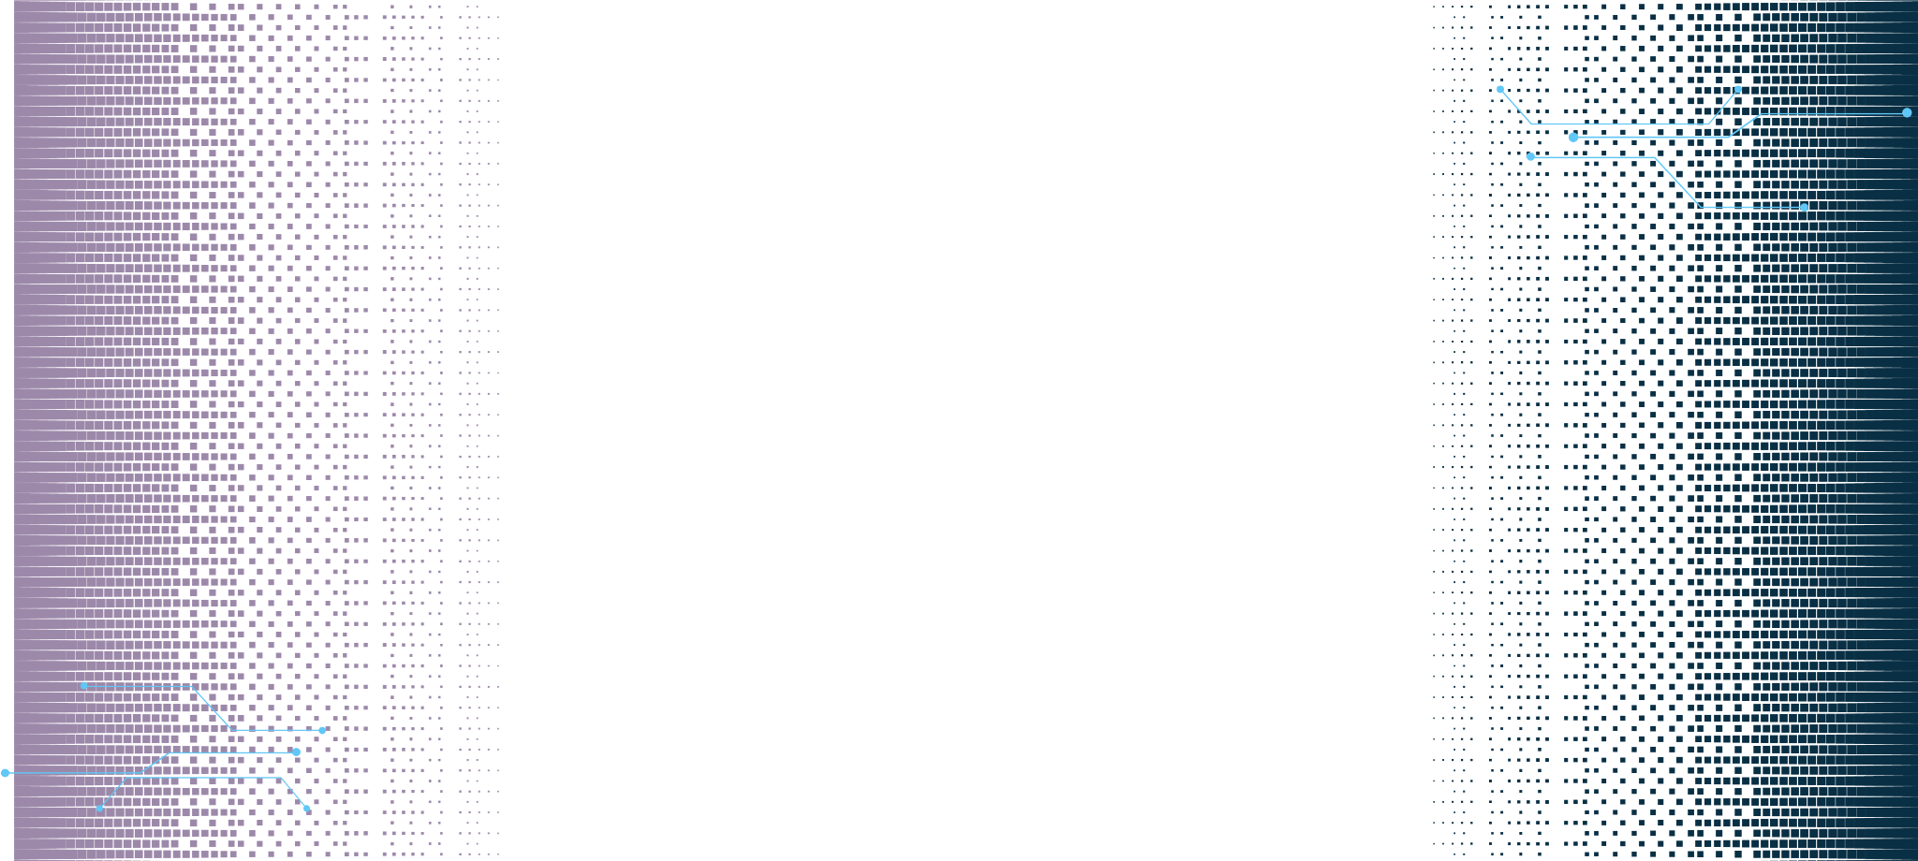
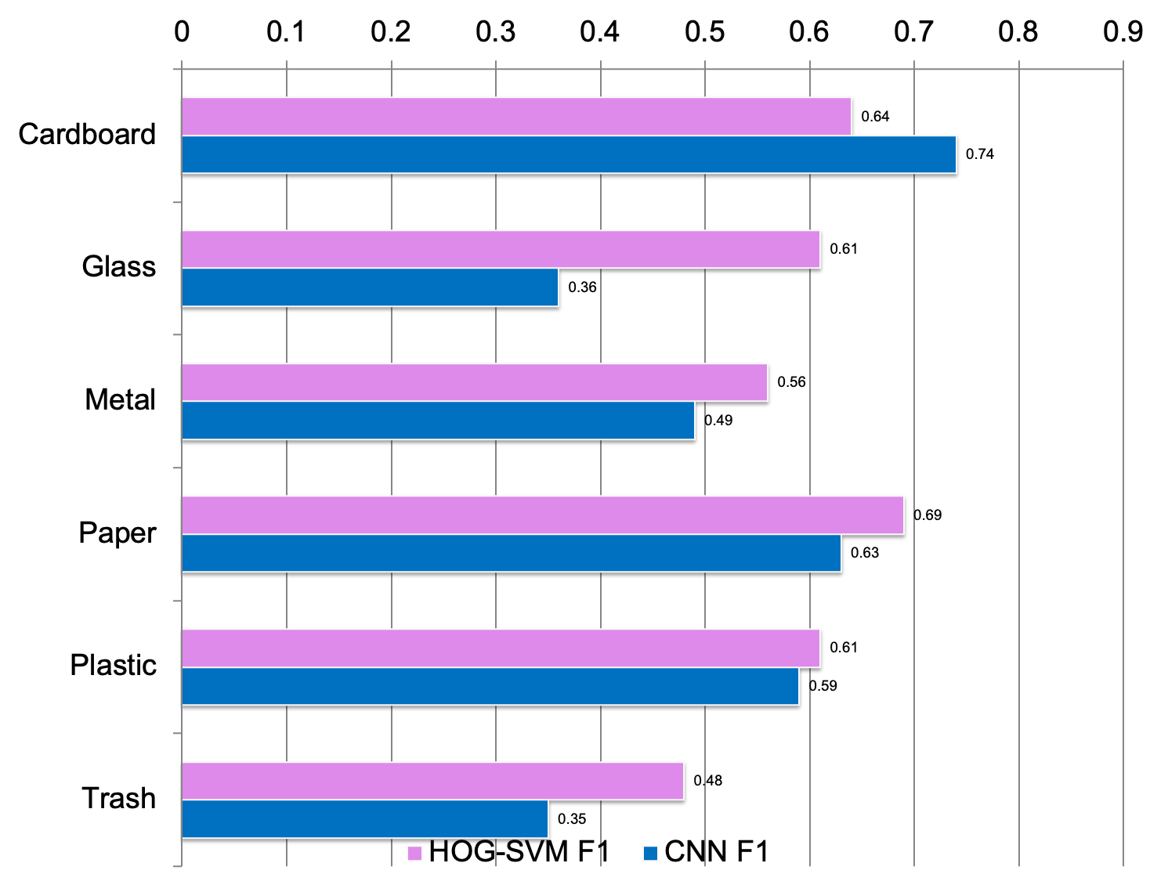



Results: class-level trade-offs
CNN advantage
Cardboard F1: 0.74 vs 0.64 for HOG-SVM.
Trash trade-off
CNN recall: 0.75, but precision: 0.23. It found more actual trash images but made many false-positive trash predictions.
Implication: the best model depends partly on the cost of different classification errors.
Notes:
The class-level F1-scores demonstrate that neither model was best in every category.
For cardboard, the CNN achieved an F1-score of 0.74, compared with 0.64 for HOG-SVM. However, HOG-SVM achieved higher F1-scores for glass, metal, paper, plastic, and trash.
The trash category presents a particularly interesting trade-off. The CNN identified a larger proportion of actual trash images, but many of its predictions labelled as trash were incorrect.
This distinction matters because precision and recall reflect different error costs. In some applications, missing an item from a particular category may be more costly. In others, incorrectly routing materials may create additional sorting work or contaminate a recycling stream.
Therefore, choosing a model requires understanding the purpose of the system and the consequences of its errors.
These findings also demonstrate why a single ranking based on accuracy is incomplete. Model performance needs to be interpreted at both the overall and class levels.

Slide 11
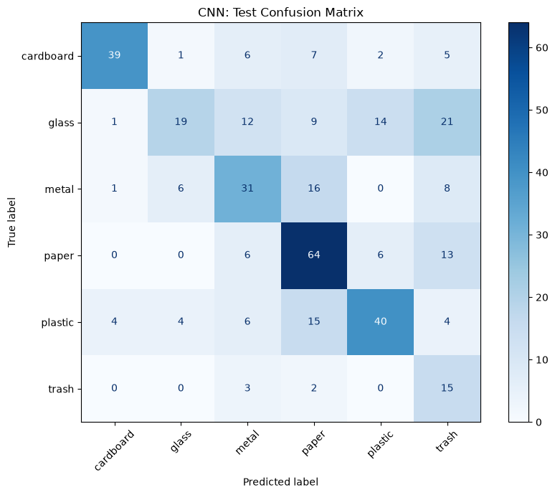

CNN: final test confusion matrix
Trash recall
15 of 20 trash images were correctly identified (75%).
Glass confusion
19 of 76 glass images were correct; 21 were predicted as trash.
Critical trade-off
Trash precision was only 23%, indicating many false-positive trash predictions.
Notes:
The final CNN confusion matrix shows that 15 of the 20 actual trash images were correctly classified. This corresponds to a recall of 75%.
However, the model also incorrectly classified 21 glass images as trash. Its precision for the trash category was approximately 23%, meaning that fewer than one in four predictions labelled as trash were correct.
This demonstrates the difference between identifying a large proportion of actual examples and making reliable predictions for a class.
In a waste-sorting environment, high trash recall could be useful if the priority were to detect as much general waste as possible. However, low precision could lead to recyclable materials being incorrectly routed as trash.
The appropriate balance depends on the operational objective, but the present results do not justify treating the CNN's predictions as reliable enough for unsupervised sorting.
The confusion matrix therefore supports a more nuanced conclusion: the CNN showed a useful strength for trash recall, but that strength came with a substantial false-positive problem.

Slide 12


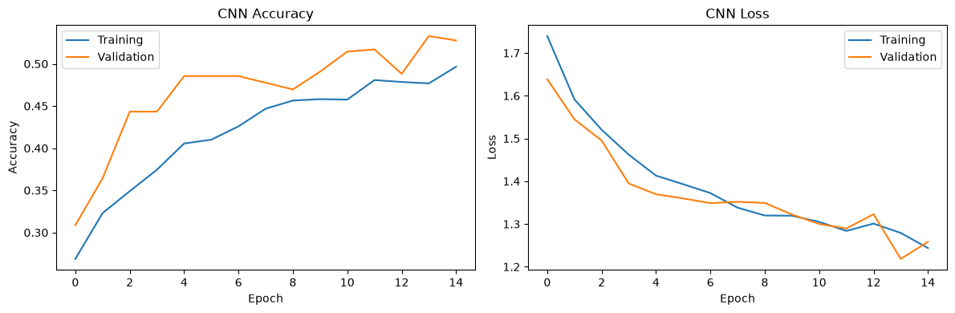
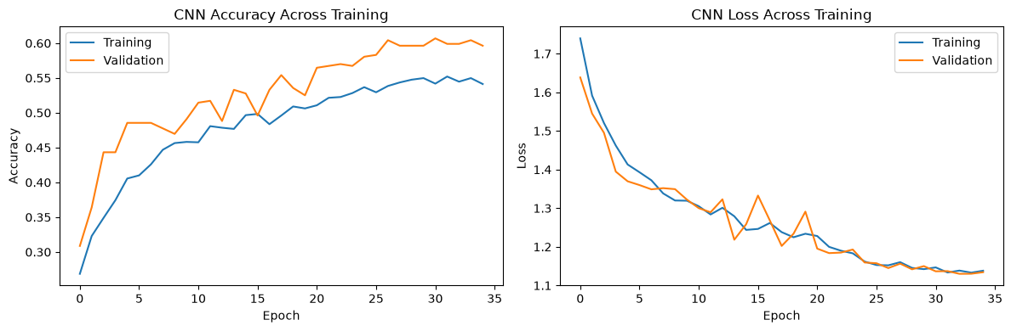
CNN training: learning and fine-tuning
The second stage continued training the same CNN; it was not an independent model.
Initial training
After fine-tuning
Validation accuracy reached approximately 0.53.
Validation accuracy reached approximately 0.61; validation loss reached about 1.13.
Test-set reuse during development limits the independence of the final test estimate.
Notes:
These plots show the CNN's accuracy and loss during its initial training and subsequent fine-tuning.
During training, accuracy generally increased and loss declined. Validation performance also improved, although the validation curves fluctuated across epochs.
During fine-tuning, validation accuracy reached approximately 0.61, and validation loss reached approximately 1.13. These observations indicate that the training process improved the model's measured validation performance.
However, validation improvement is not the same as proof of generalisation. A model may perform better on validation data but still make errors on unseen images, particularly when those images differ in lighting, background, or object appearance.
There is also a methodological concern in this experiment: I inspected the test set before and after fine-tuning. This means that the test results were part of the development process, which limits their independence.
A stronger design would use validation performance to make all training decisions, then evaluate the selected model once on an untouched test set. This would provide a more defensible estimate of performance on unseen data.

Slide 13
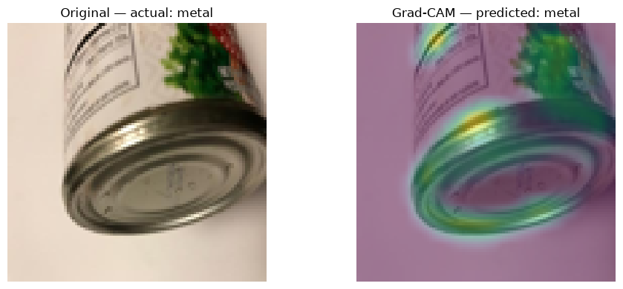
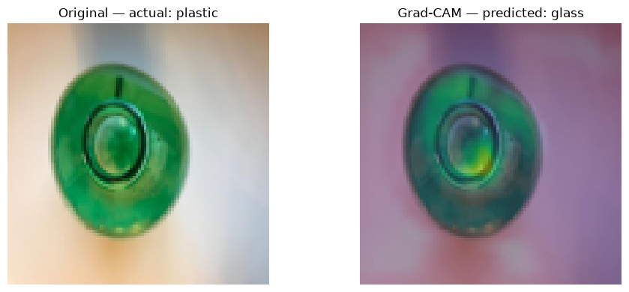

Explainability: what does Grad-CAM show?
Example 1: actual metal → predicted metal
Example 2: actual plastic → predicted glass
What it can do
What it cannot prove
Highlights regions associated with the selected CNN prediction.
A heatmap does not prove causation or that the model uses the right reasoning.
Source: Selvaraju et al. (2017).
Notes:
To investigate the CNN’s predictions, I used Grad-CAM, a technique that generates heatmaps highlighting image regions associated with a model’s prediction.
In the first example, the model correctly classifies a metal object as metal, highlighting areas around the container’s rim and lower structure.
In the second example, a plastic object is incorrectly classified as glass, with the heatmap highlighting part of the container.
These examples help us examine which image regions may influence predictions and whether the model struggles with visually similar materials.
However, Grad-CAM does not prove exactly why a prediction was made or that the model understands the material. It is an interpretability aid, not a guarantee of correctness or trustworthiness, as described by Selvaraju and colleagues.

Slide 14
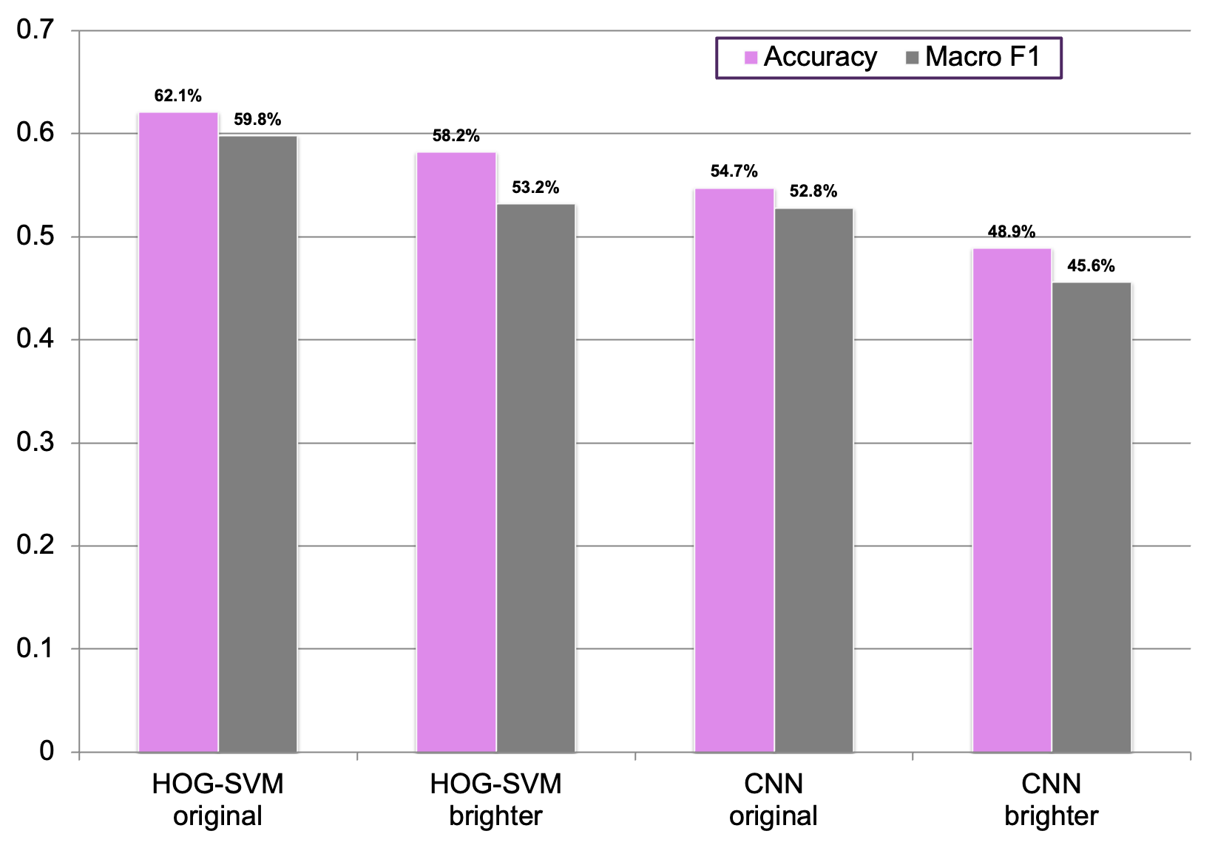

Robustness: brighter images reduced performance
HOG-SVM
Accuracy: 62.1% → 58.2%
Macro F1: 59.8% → 53.2%
CNN
Accuracy: 54.7% → 48.9%
Macro F1: 52.8% → 45.6%
A single brightness test signals sensitivity; it does not establish general robustness.
Notes:
I conducted a brightness stress test by increasing the brightness of the test images by a factor of 1.25.
For HOG-SVM, accuracy decreased from 62.1% to 58.2%, while macro F1-score dropped from 59.8% to 53.2%.
For the CNN, accuracy decreased from 54.7% to 48.9%, and macro F1-score dropped from 52.8% to 45.6%.
Both models were affected, with the CNN experiencing a larger decline in both metrics. This suggests that changes in illumination can affect classification performance.
However, this was only one stress-test condition, so we cannot conclude that the CNN is generally less robust. Further testing under different lighting conditions, backgrounds, and object orientations would be needed to assess real-world reliability.

Slide 15

Ethics and responsible deployment
Reliability & harm
Fairness & imbalance
Privacy
Incorrect routing can reduce recycling efficiency or create extra sorting work.
Class-level performance differs. No demographic attributes are available, so demographic bias cannot be assessed.
Camera systems should minimise unnecessary capture and retention of identifiable people or information.
Human oversight
Before deployment
Use review procedures for uncertain predictions and define how errors are corrected.
Validate on real facility images, monitor class-specific errors, and evaluate across varied lighting and backgrounds.
Responsible AI requires ongoing risk management—not just a one-time accuracy score.
Sources: Barocas, Hardt and Narayanan (2023); NIST (2023).
Notes:
The results raise several ethical and operational considerations.
First, classification errors can have practical consequences. If recyclable material is incorrectly identified as trash, it may be routed away from recycling. Conversely, incorrect predictions may require additional human intervention and reduce sorting efficiency.
Second, performance differs across the six waste categories. This demonstrates the importance of evaluating class-specific errors, particularly when some categories have fewer training examples. However, the dataset does not contain demographic attributes, so I cannot conclude that the models exhibit demographic bias.
Third, explainability should be used carefully. Grad-CAM helps us inspect selected predictions, but it does not prove that the model's reasoning is correct. A visually plausible heatmap should not replace quantitative evaluation.
Privacy is also relevant if camera-based classification is introduced in real facilities. Systems should minimise unnecessary collection and retention of identifiable people or personal information.
Finally, deployment should include appropriate human oversight, ongoing monitoring, and clear procedures for handling uncertain or incorrect predictions. The NIST AI Risk Management Framework provides a useful structure for identifying and managing risks throughout an AI system's lifecycle.
Given the observed performance, the brightness sensitivity, and the methodological limitations, neither model should be treated as ready for unsupervised deployment based on this experiment alone.

Slide 16

Conclusion: performance is only part of the story
01 Model comparison
02 Class-level trade-offs
03 Trustworthy use
HOG-SVM achieved stronger overall results on this experiment's test set.
The CNN had higher trash recall, but low precision created many false positives.
Explainability and stress testing reveal risks; independent evaluation remains necessary.
The best model is not simply the most complex—it is the model whose performance and limitations fit the intended use.
Next steps: untouched test set • cross-validation • real-world images • broader stress tests • human review
Notes:
To conclude, this study compared HOG-SVM and a Convolutional Neural Network for classifying six categories of waste images.
HOG-SVM achieved stronger overall results, with 62.1% test accuracy and a macro F1-score of 59.8%, compared with the CNN’s 54.7% accuracy and 52.8% macro F1-score. However, the CNN performed better on selected measures, including trash recall and cardboard F1-score.
Both models struggled with certain categories. Grad-CAM helped inspect selected CNN predictions, while the brightness stress test showed reduced performance under the tested transformation.
An important limitation is that the test set was inspected during CNN fine-tuning, meaning the final results were not completely independent.
Overall, model complexity alone does not determine effectiveness. Selection should consider performance, class-specific errors, robustness, explainability, and the consequences of misclassification.
Future work should use an untouched test set, explore cross-validation, and evaluate independently collected images under a wider range of conditions.
Ultimately, responsible machine learning requires not only accurate predictions, but also an honest understanding of limitations and appropriate safeguards.
Thank you.

Slide 17

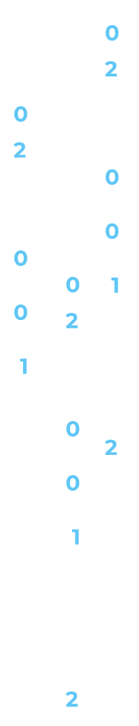
References
Barocas, S., Hardt, M. and Narayanan, A. (2023) Fairness and Machine Learning: Limitations and Opportunities. Cambridge, MA: MIT Press. https://fairmlbook.org/
Cortes, C. and Vapnik, V. (1995) ‘Support-vector networks’, Machine Learning, 20, pp. 273–297. https://doi.org/10.1007/BF00994018
Dalal, N. and Triggs, B. (2005) ‘Histograms of oriented gradients for human detection’, Proceedings of CVPR, Vol. 1, pp. 886–893. https://doi.org/10.1109/CVPR.2005.177
LeCun, Y., Bengio, Y. and Hinton, G. (2015) ‘Deep learning’, Nature, 521, pp. 436–444. https://doi.org/10.1038/nature14539
National Institute of Standards and Technology (NIST) (2023) Artificial Intelligence Risk Management Framework (AI RMF 1.0). NIST AI 100-1. https://doi.org/10.6028/NIST.AI.100-1
Selvaraju, R.R. et al. (2017) ‘Grad-CAM: Visual explanations from deep networks via gradient-based localization’, Proceedings of ICCV, pp. 618–626. https://doi.org/10.1109/ICCV.2017.74
Sokolova, M. and Lapalme, G. (2009) ‘A systematic analysis of performance measures for classification tasks’, Information Processing & Management, 45(4), pp. 427–437. https://doi.org/10.1016/j.ipm.2009.03.002
Thung, G. and Yang, M. (2016) Classification of Trash for Recyclability Status. Stanford University, CS229 project report. https://cs229.stanford.edu/proj2016/report/ThungYang-ClassificationOfTrashForRecyclabilityStatus-report.pdf
Thung, G. (n.d.) TrashNet dataset. Hugging Face. https://github.com/garythung/trashnet
Notes:
References are on this page.

